Slide 1
Persistent Identifiers [1]
Fernando Aguilar
[1] Data Discoverability and Persistent Identifiers EUDAT Summer School, Herakalion, 2017

Slide 2

What are Persistent Identifiers?
PIDs are long-lasting references to digital objects (files, webs, entity references, etc.).
An identifier is a label or code which gives a unique name to an entity: a person, place, thing…
URLs are identifiers, but they can break. A persistent identifier remains pointing to a digital entity.
PIDs have traditionally used for books, journal articles, datasets, etc.
They are extending to different entities: people, sensors, software, research or data objects…
URL
Metadata
PID
Handle
Pointer

Slide 3





PIDs in EUDAT

Slide 4
PIDs – Why?
Managing increasing numbers of data objects
Sharing data from different sources amongst researchers
Data needs to be (globally) identifiable and addressable → reuse of data
Data citation
Linking data from different sources
→ Pooling datasets, B2SAFE
Challenges
Object locations change over time
Object migration between repositories

Slide 5
What do we want from data?
Findable – Easy to find by both humans and computer systems → Metadata
Accessible – Stored for long term, accessed and/or downloaded with well-defined license and access proper protocol.
Interoperable – Ready to be combined with other datasets by humans as well as computer systems;
Reusable – Ready to be used for future research and to be processed further using computational methods. License.
The FAIR guiding Principles for scientific data management and stewardship, doi:10.1038/sdata.2016.18
Notes:
Data generation is getting easier/cheaper. And we produce more and more data, which can potentially reused.
How keep an overview over data, its location and its up-to-datedness. Especially when working in consortia where there is a more or less clear distinction between data users, data producers, data admins.
Users need to be provided with the current location of the data and maybe also their previous versions, which may lay on a different server.
Data producers upload data, but data managers who have more insight into storage might move the data around and migrate to new storage facilities.
Data might be linked to other data, how to maintain those links?
At the same time there is a Shift from data generation to data processing & analysis . A new way to do science.
As a result the number of data output is increasing. A new data world.
So as to make the data world a better place for science we must have sοme data principles in mind. The idea of these data principles are:
Findable – Easy to find by both humans and computer systems → Metadata
Accessible – Stored for long term, accessed and/or downloaded with well-defined license and access
Interoperable – Ready to be combined with other datasets by humans as well as computer systems;
Reusable – Ready to be used for future research and to be processed further using computational methods.

Slide 6
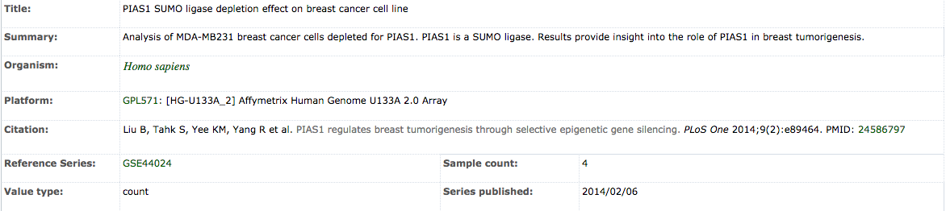
What do we need?
PID
Data
Metadata
Persistent Identifier: reference and identify object, either metadata or data object
Synchronize PID, Data and Metadata during creation, maintenance, update and deletion of a digital object!
Notes:
We need infrastructure to keep data, metadata and their PID synchronised throughout the data and research life cycle.
This becomes even more complicated when we want to keep relations between data files. At what level do we need the linking?

Slide 7

What do we need?
PID
Data
PID
Metadata
Data
Metadata
Analysed data
PID
Data
PID
Metadata
Data
Metadata
DOI
PID
Data
Raw data
Metadata
Published data
Notes:
We need infrastructure to keep data, metadata and their PID synchronised throughout the data and research life cycle.
This becomes even more complicated when we want to keep relations between data files. At what level do we need the linking?
PIDs are part of the data management. The technology can also be used to ensure the FAIR principles. To what extent and at which level we will investigate in this tutorial.

Slide 8
What do we know about Persistent Identifiers?
A Persistent Identifier (PID) is an identifier that is effectively permanently assigned to a resource.
identifier
resource location
a permanent name or identity
although it may change over time
Pointers to data resources
Globally unique
Exist infinitely long (the PID, not necessarily the data)
Notes:
An identifier is a unique name, identity applied to something so that something can be easily referenced.
- Points to a resource: The resource is a black box. The type of the url doesn't matter. It may be a file, a metadata record, a code collection.
- globally unique: Once it is created, the resource is globally addressable. You wont find an identifier with the same name that points to a different resource.
- PID is persistent over time : There is a persistent relationship between the pid and the same resource over time
The infrastructure can support access to resources as they move from one repo to another.

Slide 9
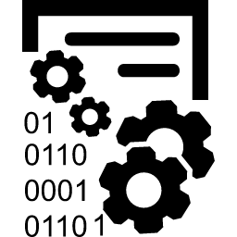
Simple data life cycle, linearised
Publish data online, data is accessed by others
Publish online
Move to another location
used by another researcher
Published online: http://www.test.com/test.html
Other users may cite, access, re-use this url
Relocate the resource at http://www.example.com/
Other users are not informed -> 404
Notes:
In order to understand PIDs and the PID service lets see and discuss a real example.
The simplest data life cycle.
You have a research output and you want to share with other researchers.
The transitional way to store your data is to upload to a site, a repository, a directory. In order to access it you bookmark or share a URL. A) Published online: http://www.test.com/test.html. B) Other users may cite, access, re-use this url
As long as nothing changes about the way the data is accessed, this works fine. But one day you decide to move the resource to another location c) Relocate the resource at http://www.example.com/
Other users are not informed about this relocation and when they are trying to acccess the resource - at the first location – they always get a Page Not Found response.
So this arrangement has proven to be fragile.
Lets see what will happen when you decide to connect to a PID service.

Slide 10
Data Life Cycle with PID system
Publish data online, data is accessed by others
Publish online
Move to another location
Used by another researcher
PIDs are subject to the same life cycle
Register PID
Update PID
Get PID Details
PID system
Handle
Resolution
service
Resolve
PID
Resolve
PID
Resolve
PID
Notes:
From the moment you decide to use PID, data and PIDs are strictly connected.
As we have already discussed, managing data online includes managing the persistent identifier for the data so that it continues to provide information about whatever it identifies—no matter where it is stored online
Data has its own lifecycle. PIDs are subject to the same life cycle.
When you decide to publish something online at the same time you must register for a PID
When you decide to move the data to another location at the same time you must inform the service and update the PID
By the time a PID is created it is always resolvable by the handle resolution service.

Slide 11
Advantages and Disadvantages
Pro:
Static reference,
even if data moves or
changes
Network of persistent links
Data – metadata relations
Provenance chains
Con:
Extra effort
What to identify?
Coordination across organisations and people
Organisational discipline to ensure persistence

Slide 12
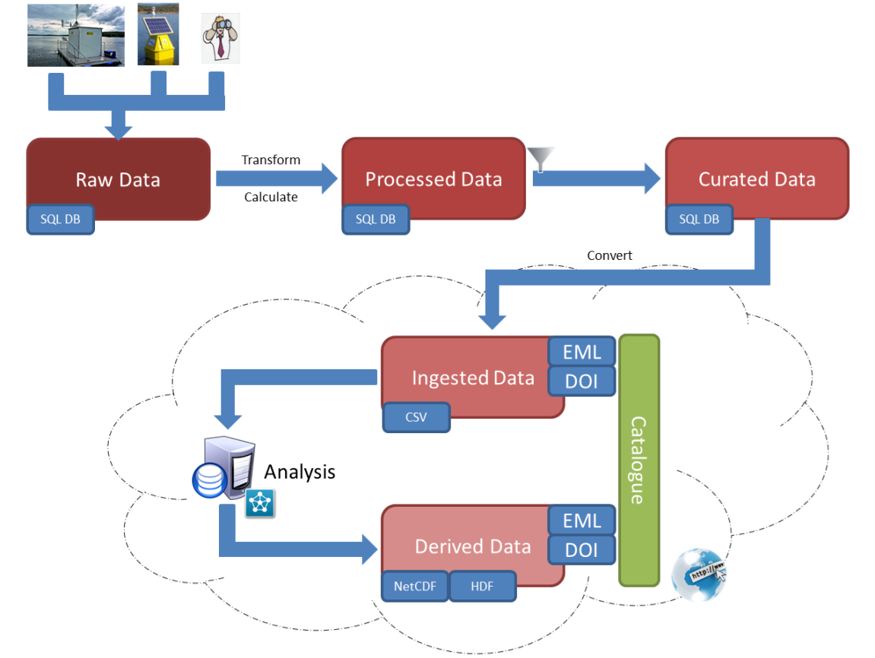
Data Life Cycle with PID-DOI
PID
PID
PID

Slide 13
PIDs Systems (Technical Solutions)
Handle System
The first persistent identifier (PID) systems were released soon after the world wide web was launched, in the mid-90s, in order to face the problems of non-persistence of the URLs.
The Handle system was the first PID solution and it was implemented in 1994. It is a distributed, general-purpose mechanism for not only identify resources but also resolve the identifiers.
It is composed of master and mirror sites administrated by the Corporation for National Research Initiatives, and thanks to this distributed structure, the service ensures reliable availability and persistence.
Example: Digital.CSIC
Persistent Uniform Resource Locators (PURLs)
It was proposed in 1995 as actionable identifiers, consisting in a URI pointing to a resolver that looks up the correct URL for the digital resource and returns it to the client via HTTP protocol.

Slide 14
PIDs Systems (Technical Solutions)
The Uniform Resource Name (URN)
It was specified in 1997 and it is a solution that does require that the resource being referred is available, but it is not extended to resolve, and other actionable features are missing.
The Archival Resource Key (ARK)
It is one of the most extended solutions for PIDs. It was released by the US National Library of Medicine and its URL-based structure includes information within the identifier like the name of the hosting authority, the name or resource ID and the qualifier.
ARK is used to get three elements: the digital object itself, the metadata and the statement indicating the current provider.
https://ezid.cdlib.org/search
https://ezid.cdlib.org/id/ark:/87278/s6057dv2

Slide 15

Digital Object Identifier (DOI)
It was released in 1998, is currently one of the most extended and used solutions in the academic environment.
The DOI is an indirect identifier for electronic documents based on Handle resolvers, that are a mechanism for permanent identification of digital content, which first tries to resolve the resource address and if it is not available, it returns the information or metadata attached to the identifier.
Many journals and editorials use currently the DOI as a bibliographic identifier, complementing other standards like ISBN. Currently, about 190 million DOIs have been assigned by commercial and non-commercial providers that participate in the International DOI Foundation.
The DOI format is composed of two sections: a numeric identifier that includes a prefix identifying the term as a DOI (10.) and a suffix identifying the publisher. The document is then identified with a separate code.

Slide 16
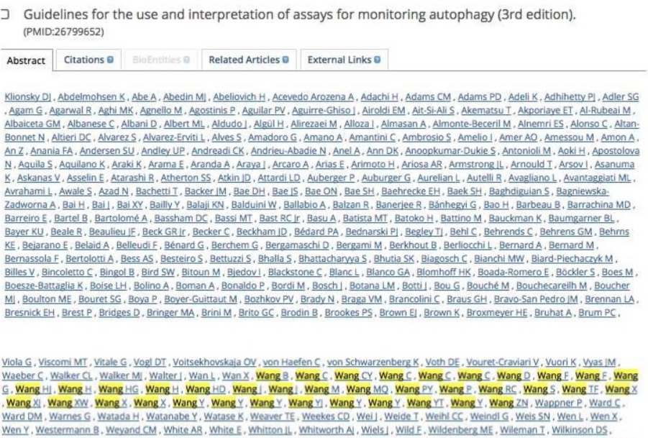

ORCID
Authors: Same name, surname
Wrong reference
Difficult to measure some indexes

Slide 17
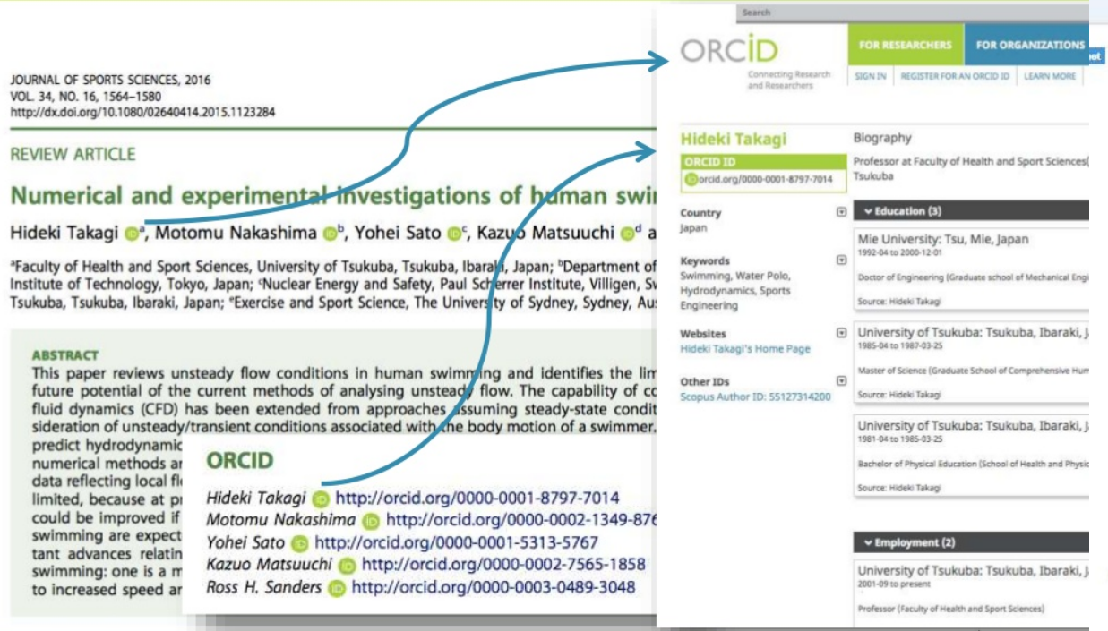
ORCID

Slide 18
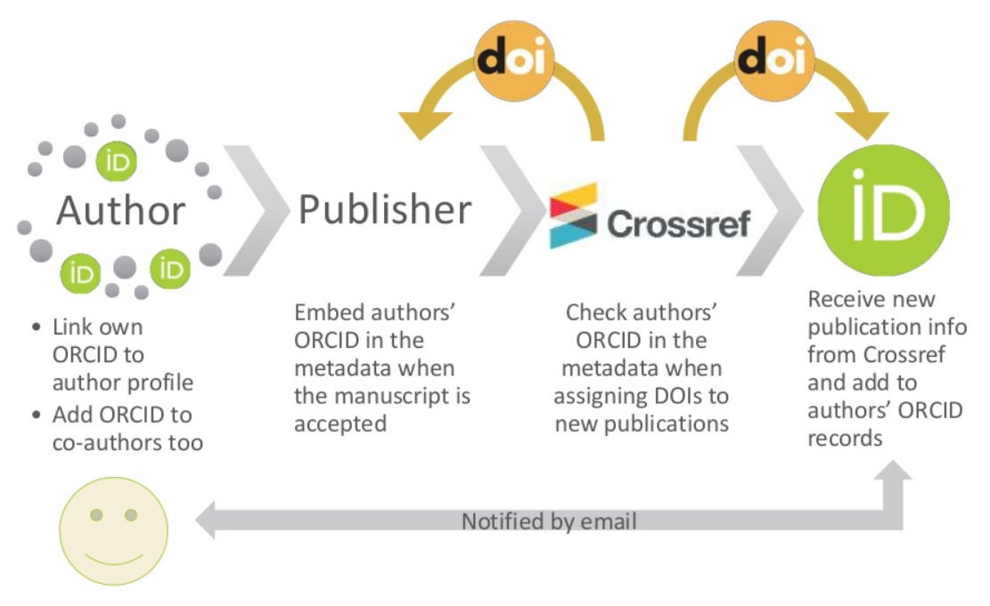
ORCID

Slide 19
How it works?
Below you find three different PIDs from three different providers.
Resolve the PIDs
Handle
Resolver http://hdl.handle.net
PID 10261/100658
DOI
Resolver http://dx.doi.org
PID 10.1038/sdata.2016.18
ARK
Resolver https://nbn-resolving.org/
PID ark:/13030/tf5p30086k
Try to resolve the ARK PID with the handle resolver.
Try to resolve the DOI PID with the handle resolver.
In the handle resolver you will find a box "Don't redirect to URLs", if you tick this box, which information do you get?

Slide 20
Use cases

Slide 21
Use Case: Data publication
PIDs point to landing page of the digital repository
showing metadata
“Real” data can be downloaded from this page with another link
E.g. B2SHARE, FigShare, Zenodo, …
PID
http://hdl.handle.net/11304/3265434c-4b34-11e4-81ac-dcbd1b51435e
resolves to landing page
https://b2share.eudat.eu/records/feafb12e810c489b9e878949c6c35345
Notes:
Safely archive data, cite published data from others

Slide 22

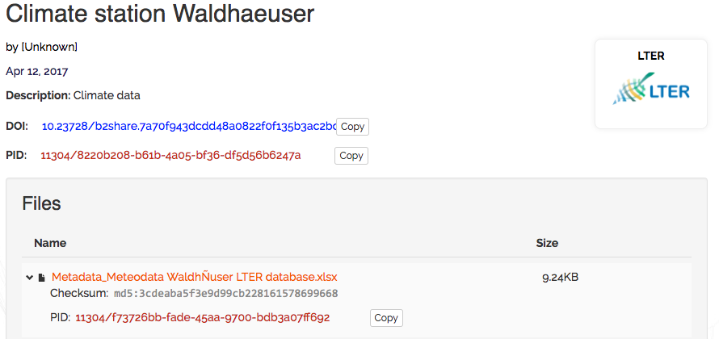
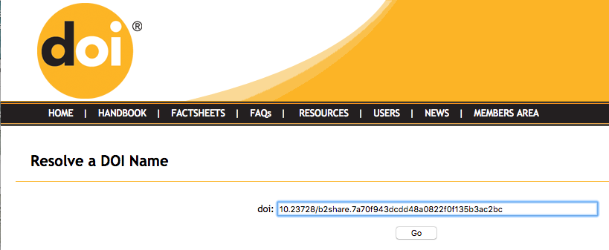
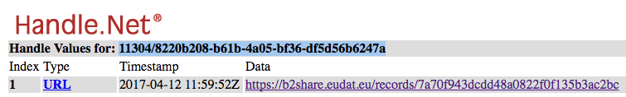
B2SHARE
The persistent identifier for the collection
M3.02 – Data Life Cycle Fernando Aguilar
Notes:
What actually happened?
The B2SHARE service made a request for a two new PIDs.
It created a DOI for the collection. This DOI is resolvable with the DOI resolver and will always resolve to the landing page in B2SHARE for the collection.
B2SHARE also created a Handle for the collection, which also resolves to the landing page.

Slide 23
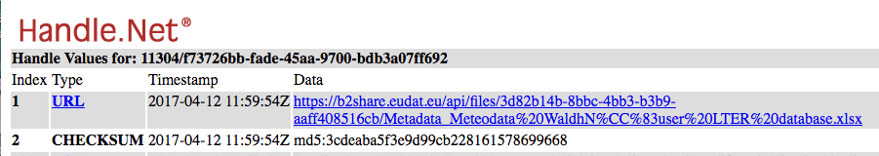
B2SHARE
The persistent identifier for files
Notes:
Moreover B2SHARE creates a PID(Handle) for each data file in the collection.
These PIDs resolve directly to the file and can be used to automatically download the files in an unambiguous way.
The PID entry also contains the md5 checksum. This field can be easily queried with e.g. the B2HANDLE python library and be employed for integrity checks.

Slide 24
Use case: Modeling Relationships
PID: prefix2/suffix2
Use tightly coupled metadata
Part of/has part relationships
(B2SAFE) Link replicas
Model cohort-patient relationship
Model patient-samples relationship
Metadata:
key1: Location2
key2: prefix1/suffix1
PID: prefix1/suffix1
Metadata:
key1: Location1
key2: prefix2/suffix2
key3; prefix3/suffix3
PID: prefix3/suffix3
Metadata:
key1: Location3
key2: prefix1/suffix1
Which metadata to store with the PID
and which in an extra catalogue?
Notes:
You can use PIDs to store extra metadata (system specific) metadata. We have seen already the use of Checksums in B2SHARE.
But we can also put links to other files and folders in the metadata and introducing relationships between singe data objects and collections.

Slide 25
Use case: Enabling data workflows

Slide 26
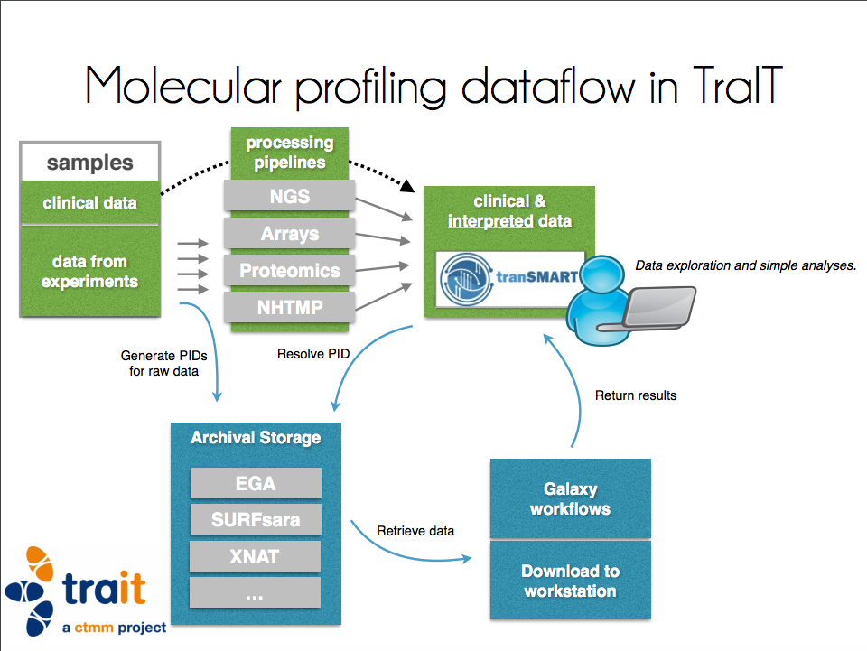
Notes:
Metadata for users resides in transMart: metadata and highly processed data
Users select data and a workflow here
The raw data or less processed data lies in various repositories and may also be moved between repositories
Rather than linking in transmart to a location in the repository, tranSMART uses PIDs, which can be updated when data moves
By this PID data can be transferred from repository to a workflow engine
Galaxy: Workflow engine, starts programs on data, pushes results back to TranSMART

Slide 27
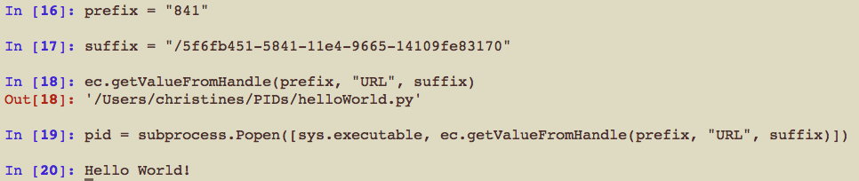
Use Case: Enabling workflows
Execute program hidden behind a PID
Way to refer to workflows → reproducibility
Notes:
Data is not only data. We can refer to code with a PID, e.g. a python file here.
By this we can refer to previously executed workflows and ensure reproducibility.

Slide 28
PIDs in EUDAT – Why?
ID2/41
ID2/42
ID1/25
ID1/26
ID1/25
ID2/41
Create PIDs
ID1/26
ID2/42
Resolve PIDs to
real location od data
Link PIDs and metadata
In human readable way
Notes:
B2SAFE, B2SHARE generate PIDs (for different purposes)
B2STAGE uses PIDs to retrieve data from B2SAFE.
B2FIND exposes metadata to the user and refers to data PID.

Slide 29
PID systems

Slide 30

Resolving PIDs
1. Client sends request to Global to resolve 0.NA/123 (prefix handle for 123/456)
Global Registry
E.g. Handle system
2. Global Responds with Service
Information for 123
3. Client gets request
to resolve hdl:123/456
IP
xc
xc
xc
...
4. Server responds with handle data
xcccxv
xc
xc
xc
..
xccx
xc
xc
xc
..
Secondary Site B
xccx
xc
xc
xc
..
#1
xcccxv
xc
xc
xc
..
xccx
xc
xc
xc
..
xccx
xc
xc
xc
..
#1
#2
xcccxv
xc
xc
xc
..
xccx
xc
xc
xc
..
#2
xccx
xc
xc
xc
..
#1
#3
Primary Site
Service Information
Local Handle Service
Secondary Site A
Local Service

Slide 31
PID systems and issuing authorities
DONA Foundation
GDWG
DataCite
SURFsara
HANDLE
DOI
EPIC
grnet
CrossRef
CSC
Notes:
PID systems do not only differ technically, but also policy-wise.
The HANDLE system is the underlying technical system for DOIs and EPIC persistent identifiers
EPIC employs the Handle system and overlays it with its own policies like “Never delete a PID”
The EPIC consortium and its members are prefix issuing authorities
The EPIC partners make sure that EPIC PIDs are always available (mirroring)
DOI also employs the Handle system
DOI uses different policies: e.g. they ask for a specific set of metadata (Author, year, title, … Dublin Core) that is stored in an extra database
DataCite and Crossref are partners and prefix issuing authorities

Slide 32

PID systems and issuing authorities
URN:NBN
Policies: PID is persistent and the data it is dereferenced to
Wants to be independent from transfer protocols
→ Currently all identifiers start with http
Might change in the future
DOI
Policies: PID is persistent, data not
Based on the handle system
Datacite, Crossref are prefix issuing authorities
Requires extra metadata, stored in another database
Both:
PIDs point to a landing page, not the file itself
→ Taylored towards data citation
User needs to provide a minimum set of metadata (Dublin Core)
Notes:
PID systems do not only differ technically, but also policy-wise.

Slide 33


PID systems and issuing authorities
ePIC (European PID consortium)
Policies: PID is persistent, data is not
PIDs can point to anything
Based on the handle system
Taylored towards data identification
and resolving
DONA foundation (www.dona.net)
Maintains global handle registry
Partners:
CNRI (developer of the handle system)
GDWG (main partner in ePIC)
International DOI foundation (IDF)
Notes:
PID systems do not only differ technically, but also policy-wise.

Slide 34
The Handle system
Metadata: You can create your own keyword-value pairs and store them with the PID
EUDAT Policies:
Handles to be maintained beyond project life time
Enforce stability of PIDs to justify trust in them
Handles can point to anything
Handles can also be removed, they are not per se persistent
…
Great flexibility for adjusting the system towards your own needs
EUDAT provides implementations for replica tracking
You have to think even more carefully about how you want to facilitate data management

Slide 35
For whom?
PIDs allow to make a distinction between data users and data managers
Data users get a PID and can directly access the data, or the metadata stored with the PID
Pipelines can programmatically access the metadata and start specific applications
Requires some serious thoughts about data organisation and developing the code to put data policies into practice, including code maintenance
For bigger research groups or consortia working in a distributed data environment
For repositories who are in need of a host for their PIDs

Slide 36
[1] Data Discoverability and Persistent Identifiers EUDAT Summer School, Herkalion, 2017
Themis Zamani, GRNET
Willem Elbers, CLARIN
Christine Staiger, SURFsara
Sofiane Bendoukha, DKRZ
Ellen Leenarts, DANS
Kostas Kavoussanakis, EPCC

Slide 37
Práctica
https://classroom.github.com/a/CUfQDR9O

